Slide 1


Water Supply Reliability Estimation: an overview
Jay R. Lund
Director, Center for Watershed Sciences
Professor of Civil and Environmental Engineering
University of California, Davis
watershed.ucdavis.edu/shed/lund/
CaliforniaWaterBlog.com

Slide 2
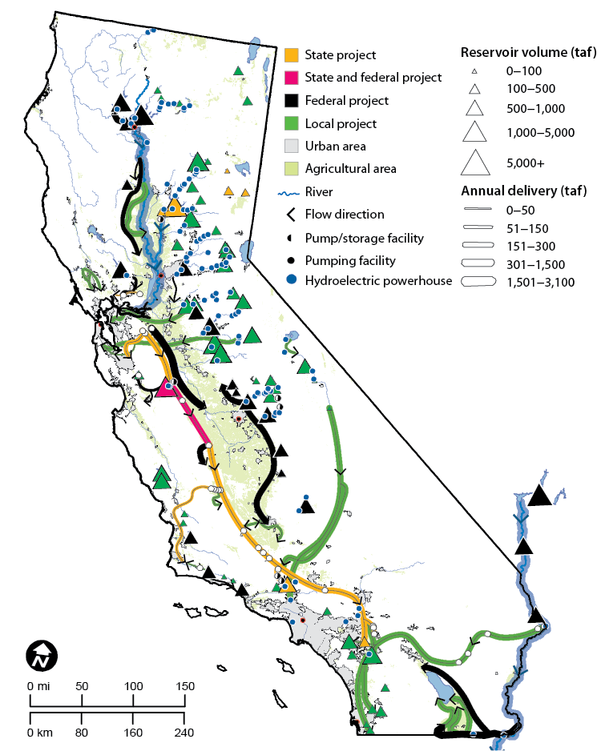
Outline
Water System Portfolios
Water demands
Sources of unreliability
Estimating Reliability
Metrics of Reliability
Lessons
2

Slide 3
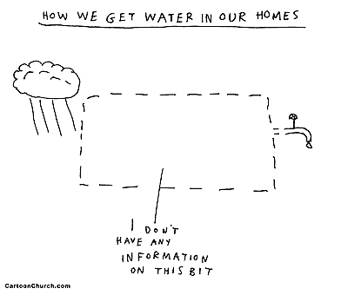
How we know our water supplies are mostly reliable.
3

Slide 4
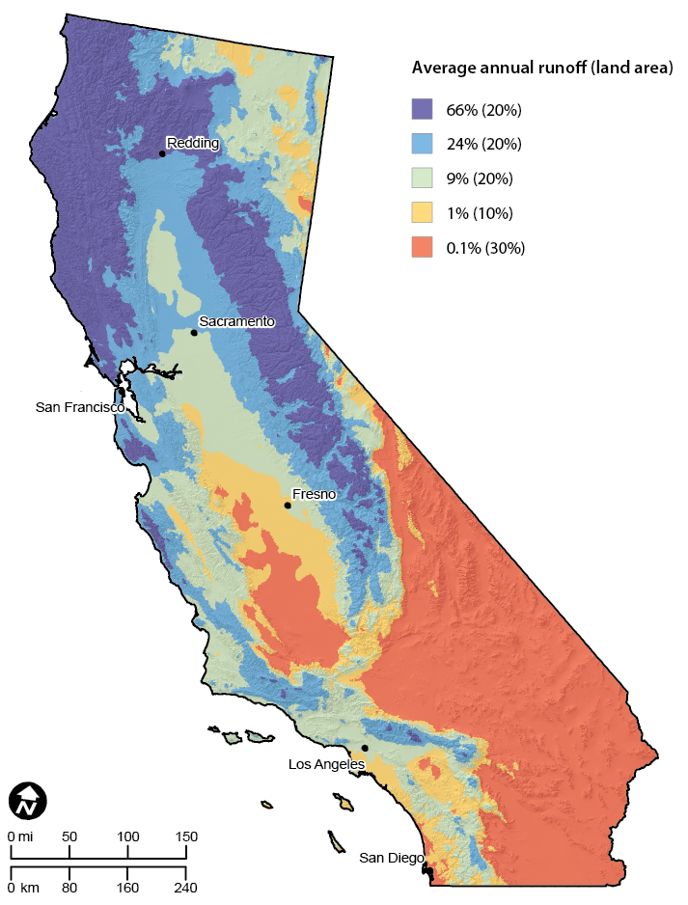

Complexity of Water in California

Slide 5
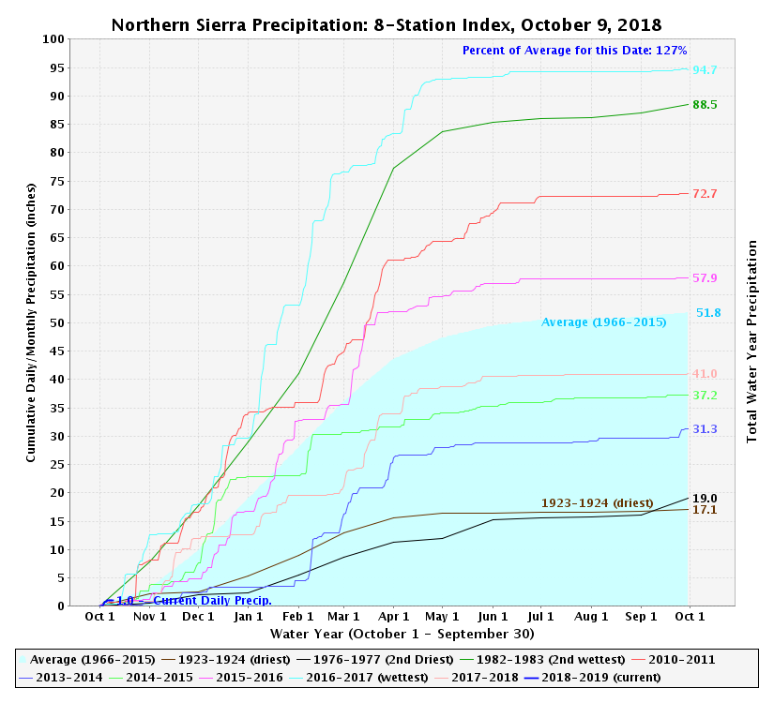
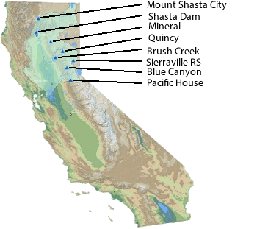
Sacramento Valley Precipitation
2016-17
1982-83
2010-11
2015-16
2015-16
2014-15
2013-14
2014:
8th driest in 106 years,
4th driest in runoff
1976-77
5

Slide 6
Most annual rainfall variability in US
Annual coefficient of variation
SOURCE: Michael Dettinger, 2011. “Climate Change, Atmospheric Rivers, and Floods in California—A Multimodel Analysis of Storm Frequency and Magnitude Changes.” Journal of the American Water Resources Association 47(3):514-523.
NOTES: Dots represent the coefficient of variation of total annual precipitation at weather stations for 1951-2008, Larger values have greater year-to-year variability.

Slide 7
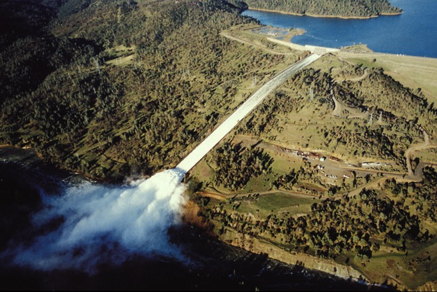
Natural Runoff Variation
Unimpaired Delta Outflow
Source: California DWR

Slide 8
Water Systems
Simple: Simplified:
Surface water
Groundwater
Water imports and exports
Urban
Farms
Fish
8

Slide 9
Water Systems
Orange County:
9

Slide 10
Water supply system portfolio actions
Water supply
Water Source availability | Treatment
Capture of fog, precipitation, streams, groundwater, wastewater | Existing water and wastewater treatment
Protection of source water quality | New water and wastewater treatment
Conveyance capacities | Wastewater reuse
Canals, pipelines, aquifers, tankers (sea or land), bottles, etc. | Ocean Desalination
 | Contaminated aquifers
Storage capacities | Operations
Surface reservoirs, aquifers and recharge, tanks, snowpack, etc. | Reoperation of storage and conveyance
 | Conjunctive use
Water demands and allocation
Agricultural use efficiencies and reductions | Ecosystem demand management
Urban water use efficiencies and reductions | Recreation water use efficiencies
Incentives to work well together
Pricing | Subsidies, taxes
Markets | Education
“Norming”, shaming
3

Slide 11
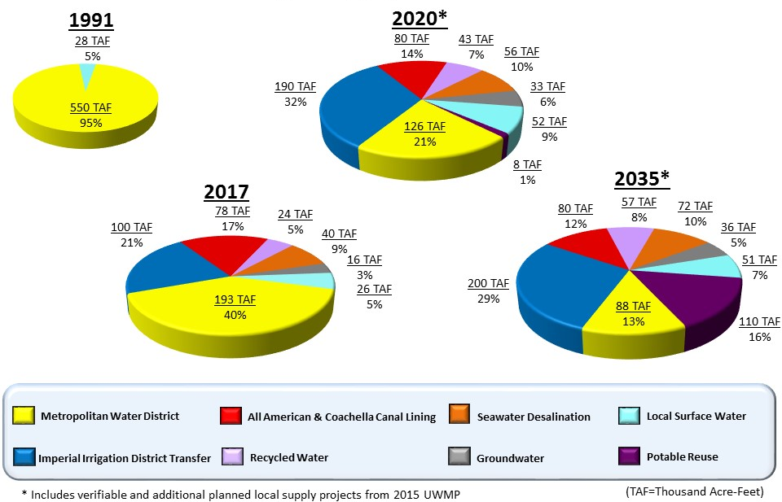
San Diego water supply portfolio
578 taf/yr
588 taf/yr
694 taf/yr
477 taf/yr
11

Slide 12
Local and Statewide Portfolio
Local Activities:
- Conservation and use efficiency
- Wastewater reuse
- Desalination (brackish & ocean)
- Groundwater use and recharge
- Surface reservoir operations
- Water markets and exchanges
Statewide Activities:
- Inter-regional water conveyance
- Surface reservoir operations
- Plumbing codes & conservation incentives
- Groundwater banking and recharge
- Water market support and conveyance
- Wastewater reuse subsidies
Integrating mix of actions – portfolio planning.

Slide 13
Water Demands
Many types of water demands/uses
  Urban – landscaping, sanitation, drinking, etc.
  Agriculture – trees, vegetables, pasture, etc.
  Environmental – water quality/dilution, habitat, ecosystem support, etc.
Demands vary with time (hour, season, historical)
Uses and shortages are not all equally valued
13

Slide 14
Two Views of Water Demands
Point demands Value/demand curves
Use U
Use A
Use E
Total Value of delivery
Use A
Point demand volume
Use E
Use U
Time of year
Volume delivered to use at time t
Consequences of “shortage”
“There is a shortage of sport cars – I don’t have one.”
“There is rarely a shortage of water, but often a shortage of cheap water.”
14

Slide 15
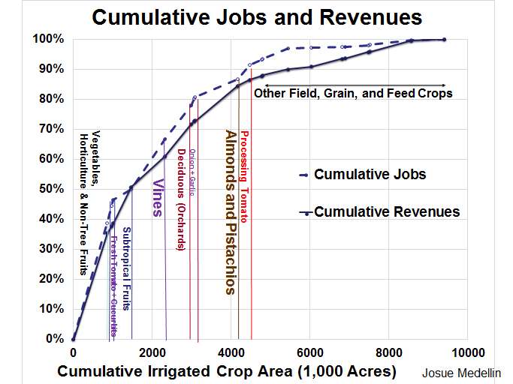

Slide 16
Sources of Unreliability
Lack of inflow, drought
Flood
Earthquakes, wildfires, etc.
Mechanical and operational failures (Flint)
Water demands
Regulations
Unreliable rules or agreements
Multiple failures
16

Slide 17
Representing Sources of Unreliability
Events, time series, or probabilities
Based on:
  Historical experiences
  Scenarios of concern
  Synthetic cases
Use many time series – Monte Carlo types of analysis
17

Slide 18
System Simulation Models
Simple system:
Model inputs:
  Capacities
  Inflows
  Water demands
  Operating rules
Model outputs:
  Deliveries
  Storages
  Losses
Surface water
Groundwater
Water imports and exports
Urban
Farms
Fish
Time-step simulation:
Rules and capacities
Conservation of mass
18

Slide 19
Estimating System Reliability
Simulation modeling (“What if?” modeling)
Representing/simplifying legions of details, capacities, and responses
Running simulation for each case to estimate responses and consequences
Assigning probabilities
Assess overall reliabilities and consequences
19

Slide 20
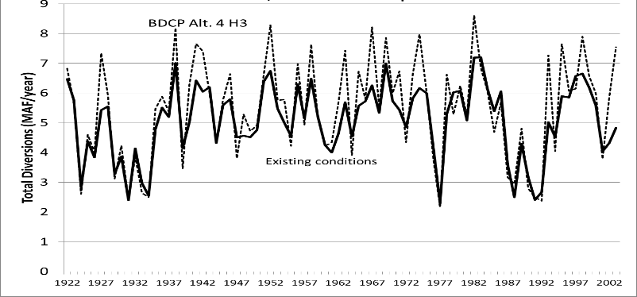
Model Results to Reliabilities
Delivery-reliability for a “level of development”
Time-series of model results
Probabilities of results
20
from DWR data 2015

Slide 21
Seasonal Operation Reliabilities
Reliability by “Position Analysis”
Today’s storage
Forecast demands
Many future inflows
from Murk 1995
Minimum storage in millions of gallons
Probabilities of storage or delivery results
21
from Hirsch 1978

Slide 22
Estimating System Reliability
“All models are wrong, but some are useful.”
Delivery reliability models and results
Importance of model interpretation
22
from DWR data 2015

Slide 23
Modeling “Errors” Unavoidable
“All models are wrong, but some are useful.” G.E.P. Box 1978
“The purpose of computing is insight, not numbers.” R. Hamming 1962
Model components:
Model software (formulation, calibration, version)
Input data (hydrology, demands, operating rules)
Modeler (orchestration + interpretation)
Interpretation and documentation fundamental.
23

Slide 24
SWP Delivery Capabilities Reports
Estimates SWP delivery capabilities overall and for individual contractors for historical hydrology and present conditions - updated every 2 years
24
from DWR 2018

Slide 25
Orange County
Complex local & regional system
Multiple supplies raise reliability
Climate and Waterfix matter
25
From OCMWD 2016

Slide 26
MWD’s Integrated Resources Plan
Modeling integrates diverse knowledge
As a wholesaler, demands are important to their reliability
Prefer >1 maf in storage
26

Slide 27
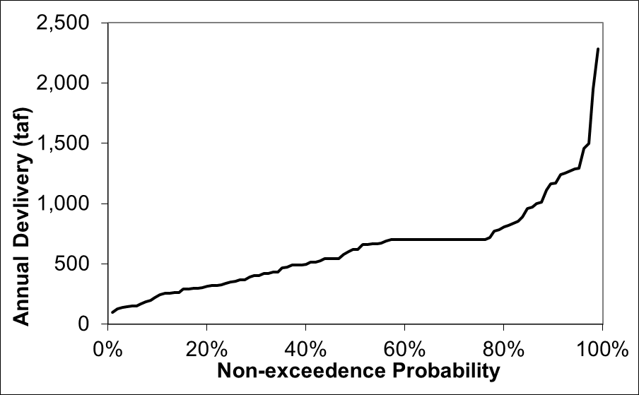
Reliability in a Portfolio of Actions
Agricultural example:
Surplus to bank, sell, or exchange
Purchase water for trees
Fallow annual crops
Pump more groundwater
Delivery target
Surface water delivery
27

Slide 28
Metrics of Reliability
Many metrics proposed and used for different purposes
“Firm Yield” – 100% modelled reliability for historical inflow record
Reliability for delivery target volume
Robustness, resiliency, vulnerability
Expected annual damage
Probability distributions of performance
28

Slide 29
Climate change and reliability
More seasonal and inter-annual variability in surface water supplies – groundwater more important
29
from DWR data 2015

Slide 30
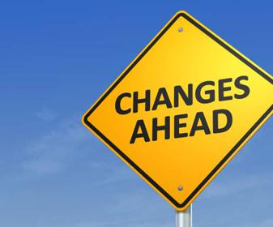
Many Forms of “Non-Stationarity”
Climate
  Sea level rise
  Warming
  Precipitation change
  Extreme whiplash
Deterioration
  Aging infrastructure
  Contaminants – salts, nitrates, etc.
  Mining legacy
  Groundwater overdraft
  Earthquakes
  Sacramento-San Joaquin Delta
Water demands
  Crop commodity prices
  Conservation actions
  Population growth and urbanization
Ecosystems
  New invasive species
  Continued degradation
Science and technology
  New chemicals
  New technologies
Management
  Regulations
  Agreements
  Funding
  Storage operations
  Infrastructure capacities

Slide 31
Some Issues and Lessons
Reliability estimates integrate knowledge of system, demands, supplies, and operations
Reliability of components vs. reliability of system (Delta reliability vs. system reliability)
Portfolio reliability & management are key
Model results have both insights and “errors”
Importance of interpretation and insights
Non-stationarity has many forms
Demand interpreted delivery-reliability plots!
31

Slide 32
Suggested Readings
Hazen, A. (1914), “Storage to be provided in impounding reservoirs for municipal water supply,” Transactions ASCE, Vol. 77, pp. 1539-1669.
Hirsch, R.M. (1978), Risk Analyses for A Water-Supply System … , Open File Report 78-452, USGS
Kuria, F., Vogel, R.M., Uncertainty Analysis for Water Supply Reservoir Yields, J. of Hydrology, 2015.
DWR, State Water Project Delivery Capability Report 2015.
MWDSC, Technical Appendix, Integrated Water Resources Plan Update 2015
MWDOC, Orange County Water Reliability Study, December 2016
Lund, J. "California’s Agric. & Urban Water Supply Reliability and the Sacramento–San Joaquin Delta," SFEWS, October 2016.

Slide 33
Is this true for us?
Richard Hamming, 1968
“Indeed, one of my major complaints about the computer field is that whereas Newton could say, "If I have seen a little farther than others, it is because I have stood on the shoulders of giants," I am forced to say, "Today we stand on each other's feet."
Perhaps the central problem we face in all of computer science is how we are to get to the situation where we build on top of the work of others rather than redoing so much of it in a trivially different way. Science is supposed to be cumulative, not almost endless duplication of the same kind of things.”
33

